Slide 1
Transparency and Reproducibility in Economics: Lessons learned from 1,000 papers
Lars Vilhuber
Cornell University
Braga – Universidade do Minho – 2022-12-16
The opinions expressed in this talk are solely the authors, and do not represent the views of the U.S. Census Bureau, the American Economic Association, or any of the funding agencies.
© Lars Vilhuber .
Notes:
I am going to
Very briefly describe the background we are coming from
Make note of the various elements of progress (and the broader picture) of open science
Describe some of the ongoing challenges
Provide some guidance based on the lessons learned in the past year

Slide 2
3 Lessons (and many solutions)
Lesson 1: Computational empathy
Lesson 2: Data acumen
Lesson 3: Role of institutions

Slide 3
Let me expand that a bit…

Slide 4
For students and researchers
0. Do not necessarily learn from previous papers
Have computational empathy for …
Track data whenever used
Learn the basic … of programming
Learn to automate
Preserve it all (and version it too)

Slide 5
For institutions
(departments, schools, libraries, IT, universities)
Offer training in adapted tools
Highlight appropriate community or university sites
Provide streamlined access to some frequently used (open/commercial) tools

Slide 6
For faculty
Encourage students to learn skills you don’t know
Demand reproducibility when reviewing (articles, theses, intermediate reports from students, etc.)
Incentivize reproducibility

Slide 7
A bit of background

Slide 8

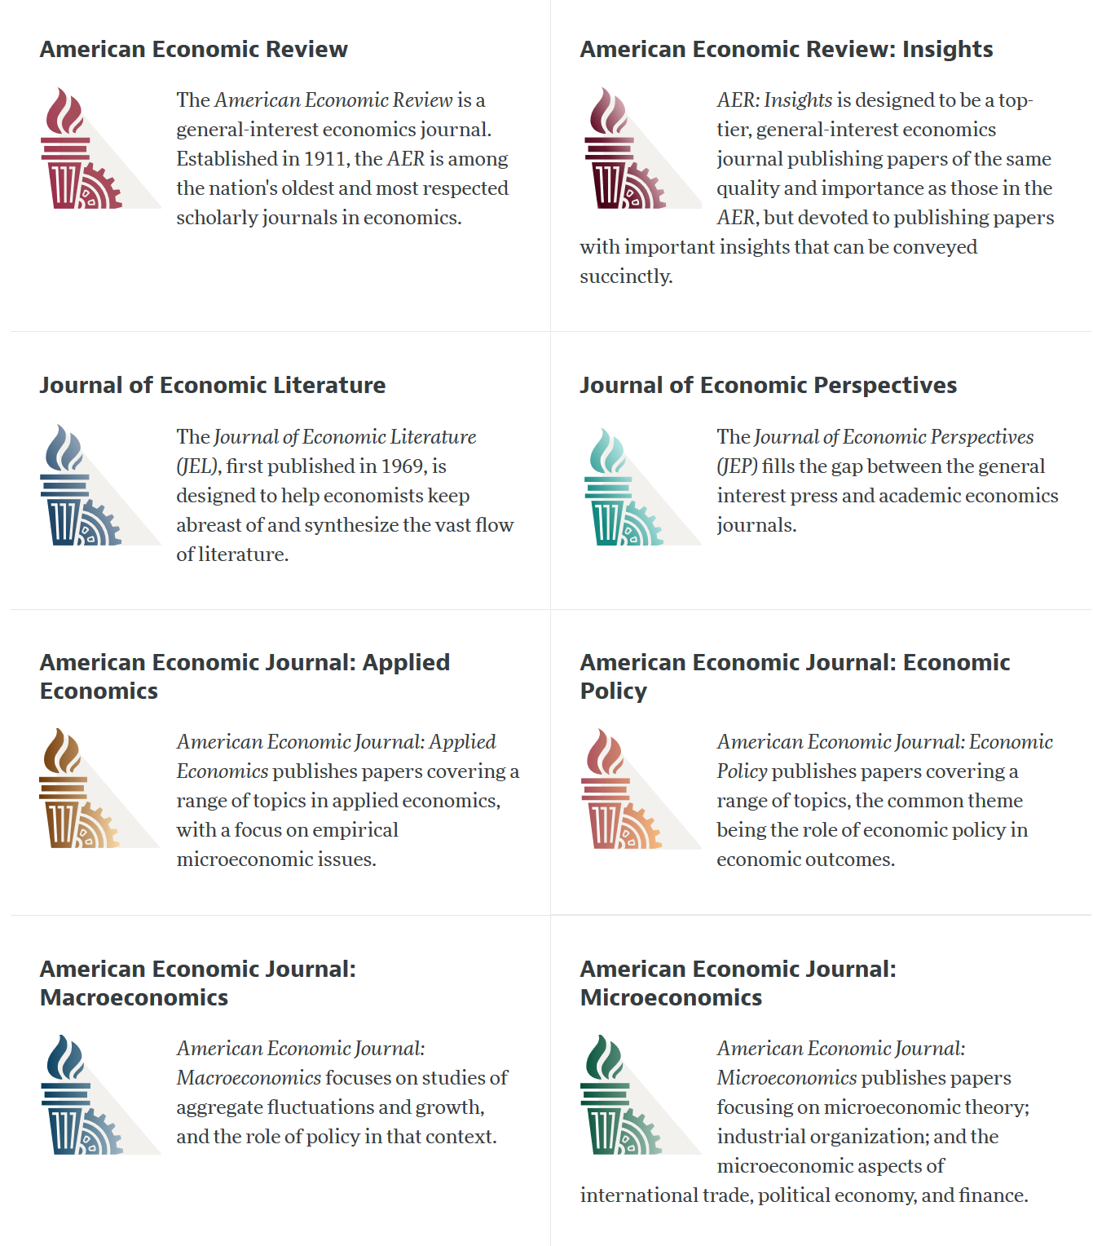

Slide 9
AEA Data & Code Availability Policy (2019)
It is the policy of the American Economic Association to publish papers only if the data used in the analysis are clearly and precisely documented and access to the data and code is clearly and precisely documented and is non-exclusive to the authors.
Authors of accepted papers that contain empirical work, simulations, or experimental work must provide, prior to acceptance, the data, programs, and other details of the computations sufficient to permit replication, as well as information about access to data and programs.

Slide 10
Current efforts at the AEA
Pre-emptively improve code archives
By conducting reproducibility checks when we can
By working with groups that conduct reproducibility checks when we cannot
Better archives
Greater transparency of the code and data archives
Better provenance tracking
Leave code where it is when appropriate
Leave data where it is almost always
Display that information
Notes:
Add logo from AEA

Slide 11
AEA Pre-Publication Verification
Every paper that receives a “conditional acceptance” is verified
Data citations
Quality of README
Quality of code
Reproducibility of code
Quality of metadata in the repository

Slide 12
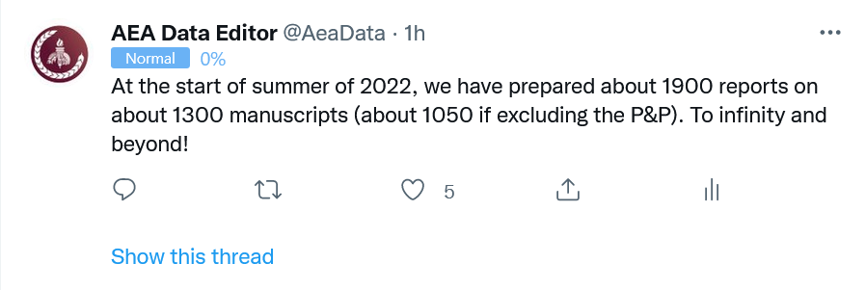
Stats on reproduced articles
Between July 16, 2019, and June 20, 2022, the AEA Data Editor team conducted
1900 assessments
for 1050 manuscripts (full papers)

Slide 13
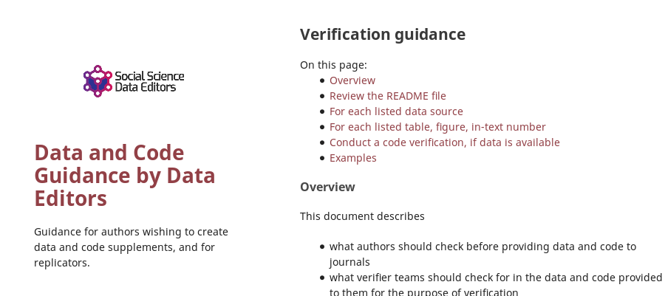

Reproducibility Verification

Slide 14
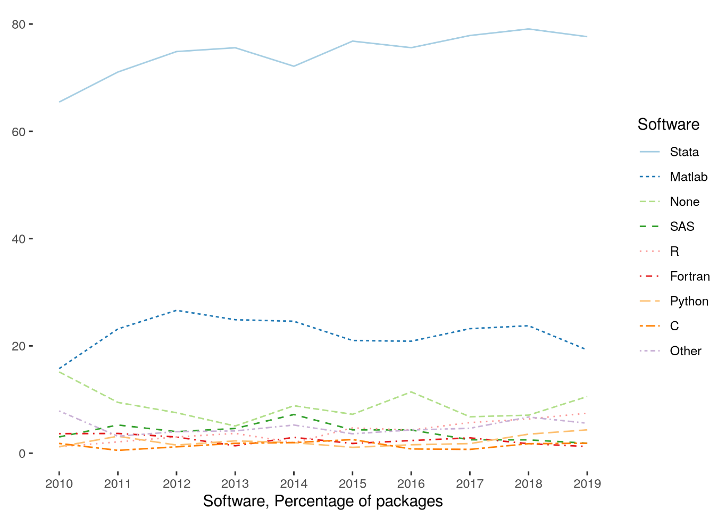
Very little diversity in software
Stata is the most popular statistical software in the journals of the AEA (72.96% of all supplements, 2010-2019)
followed by Matlab (22.45%)

Slide 15
Defining “reproducible research”
“Reproducibility” refers to the ability of a researcher to duplicate the results of a prior study using the same materials and procedures as were used by the original investigator.
Bollen et al. 2015. “Social, Behavioral, and Economic Sciences Perspectives on Robust and Reliable Science.” National Science Foundation.https://www.nsf.gov/sbe/AC_Materials/SBE_Robust_and_Reliable_Research_Report.pdf.

Slide 16


Ingredients of “research”
“Procedures” = computer code
“Materials (1)” = data
“Materials (2)” = computers

Slide 17
Lessons?

Slide 18
Observation 0
Researchers don’t…
Re-run their code before submitting
Don’t streamline (automate) enough
Are not careful about how they document data sources
Fail to curate their own data

Slide 19
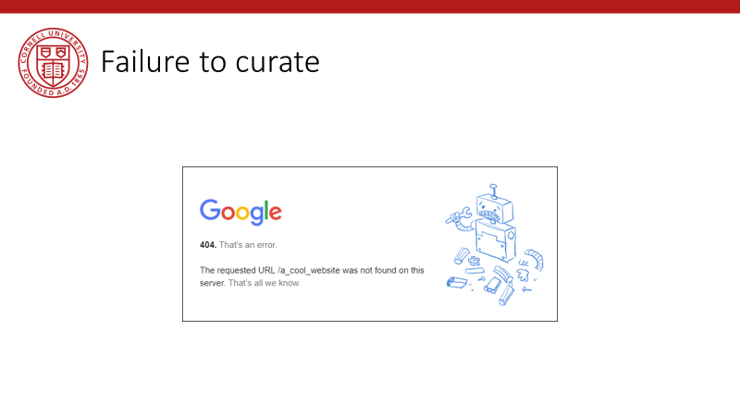
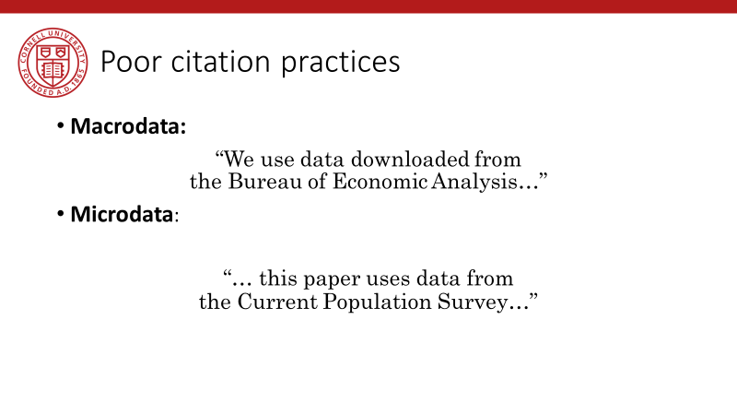
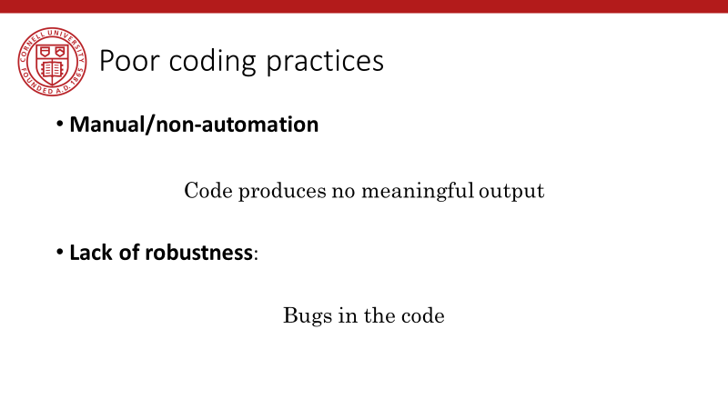
Back in 2019…

Slide 20
Lessons!

Slide 21
Computational empathy

Slide 22
Lesson 1: Computational empathy
In the words of the slogan popularized by Buckheit and Donoho (1995),
“a scientific publication is [...] merely advertising of the scholarship: [...] the complete software development environment and the complete set of instructions which generated the figures.”

Slide 23
Lesson 1: Computational empathy
Put yourself in the position of the reader of the research compendium:
Can they understand those instructions?
Under what premises/ shared common knowledge?
What might they assume about the computing environment?
How concise or diffuse are the instructions?

Slide 24
Lesson 1: Computational empathy
Potential readers
You (in 4 years, between prepping 2 new courses, an R&R, a new child, and tenure coming up in 2 years)
Your RA (in 4 years, because you are… see above)
Your future readers who will cite you (in 4-10 years, who may want to extend or replicate your study, but won’t if it is too complex)

Slide 25
Lesson 1: Computational empathy
= “Pity the poor replicator”

Slide 26
Intermezzo

Slide 27
Observation 1
Social scientists do not read the manual
(beyond the first few pages)

Slide 28
Observation 1: Please read the manual
Persistent misconceptions
About setting working directories
How to record pathnames
How to leverage loops
How to leverage subroutines
How to pass parameters
How (and if) to use controller scripts

Slide 29
Observation 2
Social scientists love point-and-click interfaces (which are hard to reproduce)

Slide 30
Observation 2: point-and-click interfaces
This is reflected in
GIS (maps) that appear in papers
Data extraction tools
How to run software (any software)

Slide 31
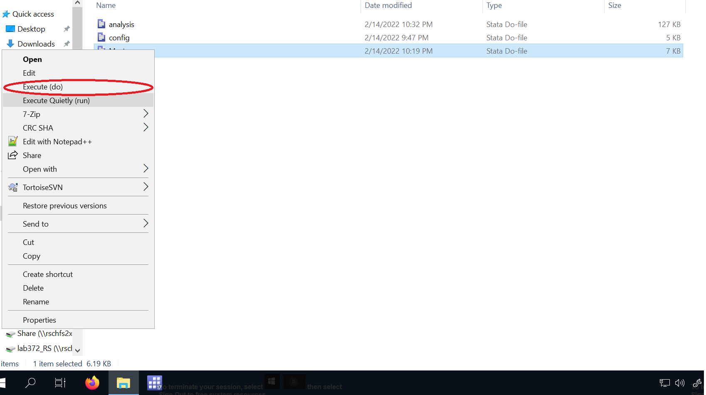
Ask yourself: how do you run….
Stata
Open Stata, find file, Select-all, click on green arrow thingy
Right-click on file, choose “Execute”
At the bash prompt, type “stata –b file.do”

Slide 32
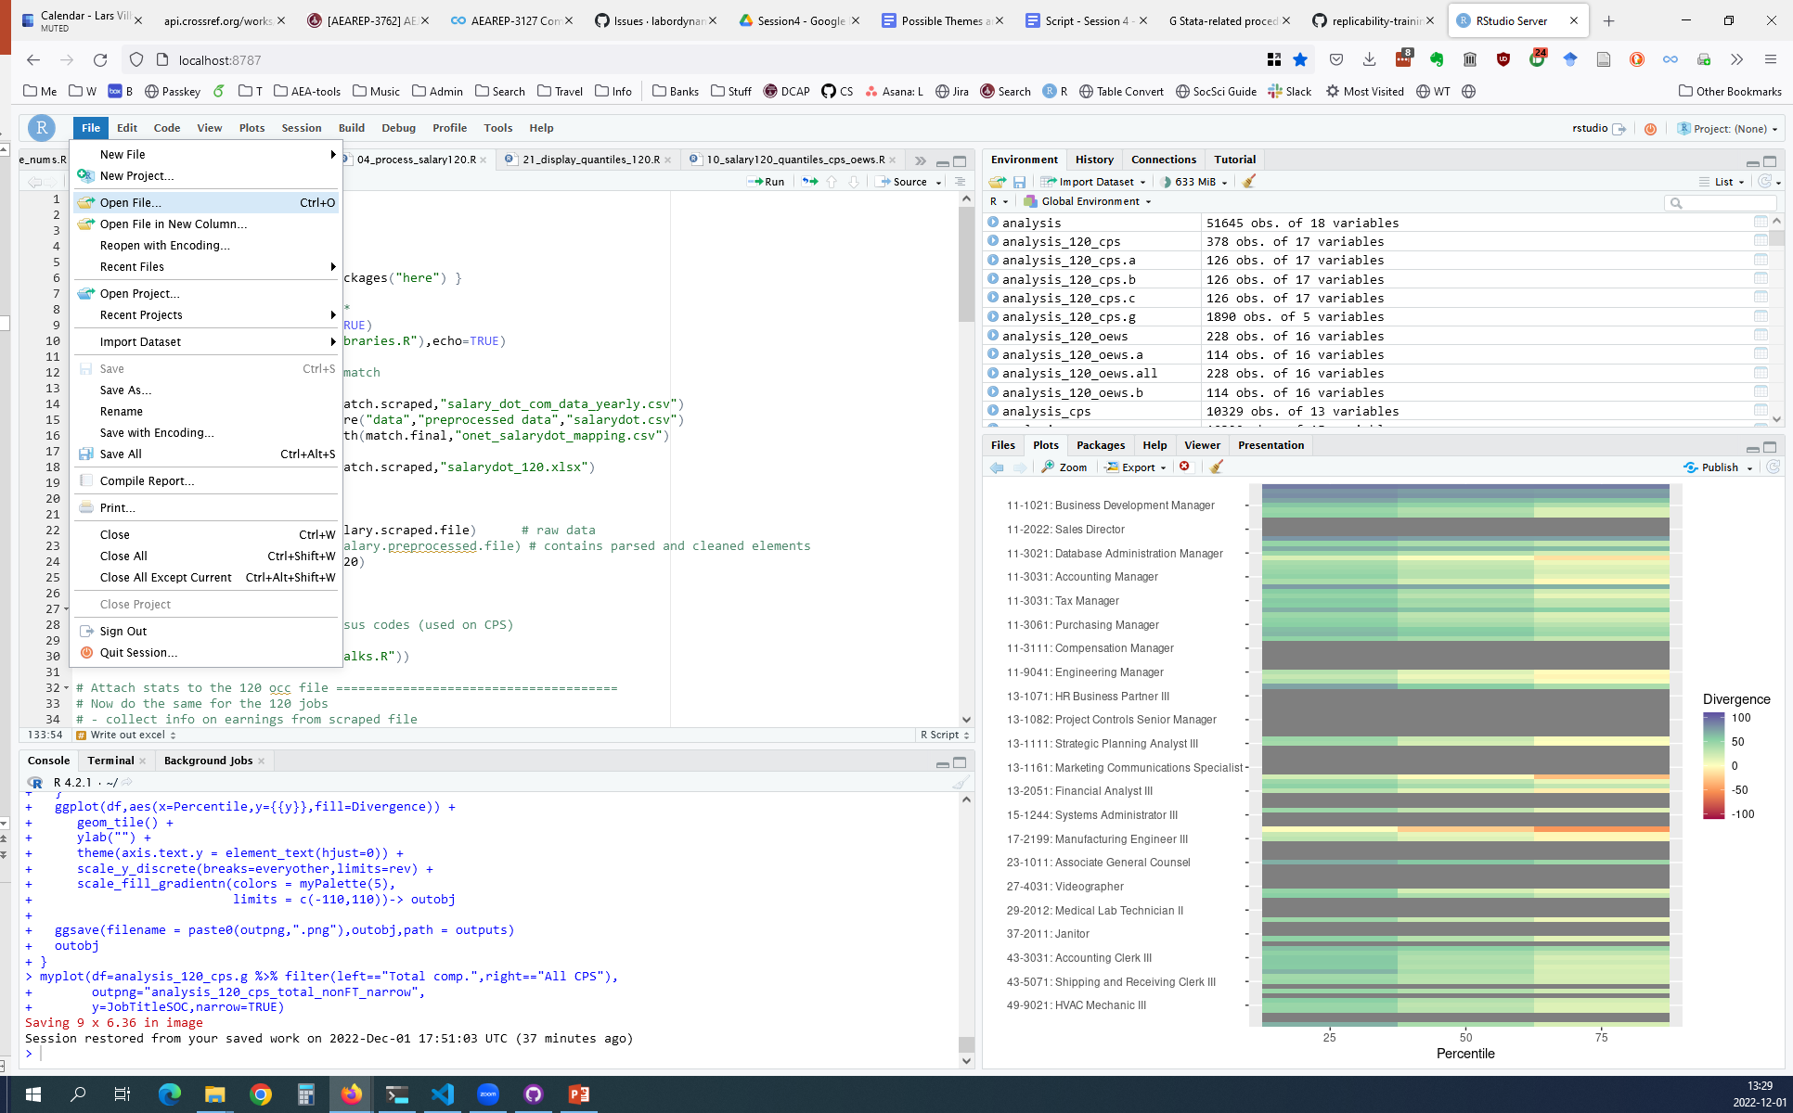
Ask yourself: how do you run….
R
Open Rstudio, open File, click on “Source” button
Double-click on Rproj file, open File, click on “Source” button
From bash prompt, type “R CMD BATCH file.R”
From bash prompt, type “Rscript file.R”

Slide 33
All these methods can work
But
They will yield different vestiges of running (log files, etc.)
They will require programs to be written differently! (working directories, etc.)
They are not necessarily compatible with each other

Slide 34
Observation 1 and 2 are the result of a lack of Computational Empathy, and lead to high burden of reproducibility and replicability

Slide 35
Solutions?

Slide 36
Hold that thought, we will get there.

Slide 37
Data acumen

Slide 38
Data acumen
“the ability to understand data, to make good judgments about and good decisions with data, and to use data analysis tools responsibly and effectively”
National Academies of Sciences, Engineering, and Medicine. 2018. Data Science for Undergraduates: Opportunities and Options. Washington, DC: The National Academies Press. https://doi.org/10.17226/25104.

Slide 39
Lesson 2: Data acumen in the context of reproducibility
Two key components
Data provenance
Where did the data come from which I used?
Data preservation
Where do I put the data I generated?
What if the data I used are not “robustly preserved”?
What do you mean by that?

Slide 40
Data provenance

Slide 41
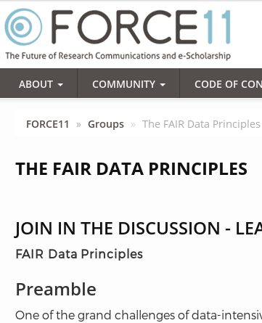
Action: Data citations and metadata
What is FAIR?
Findable,
Accessible,
Interoperable, and
Re-usable

Slide 42
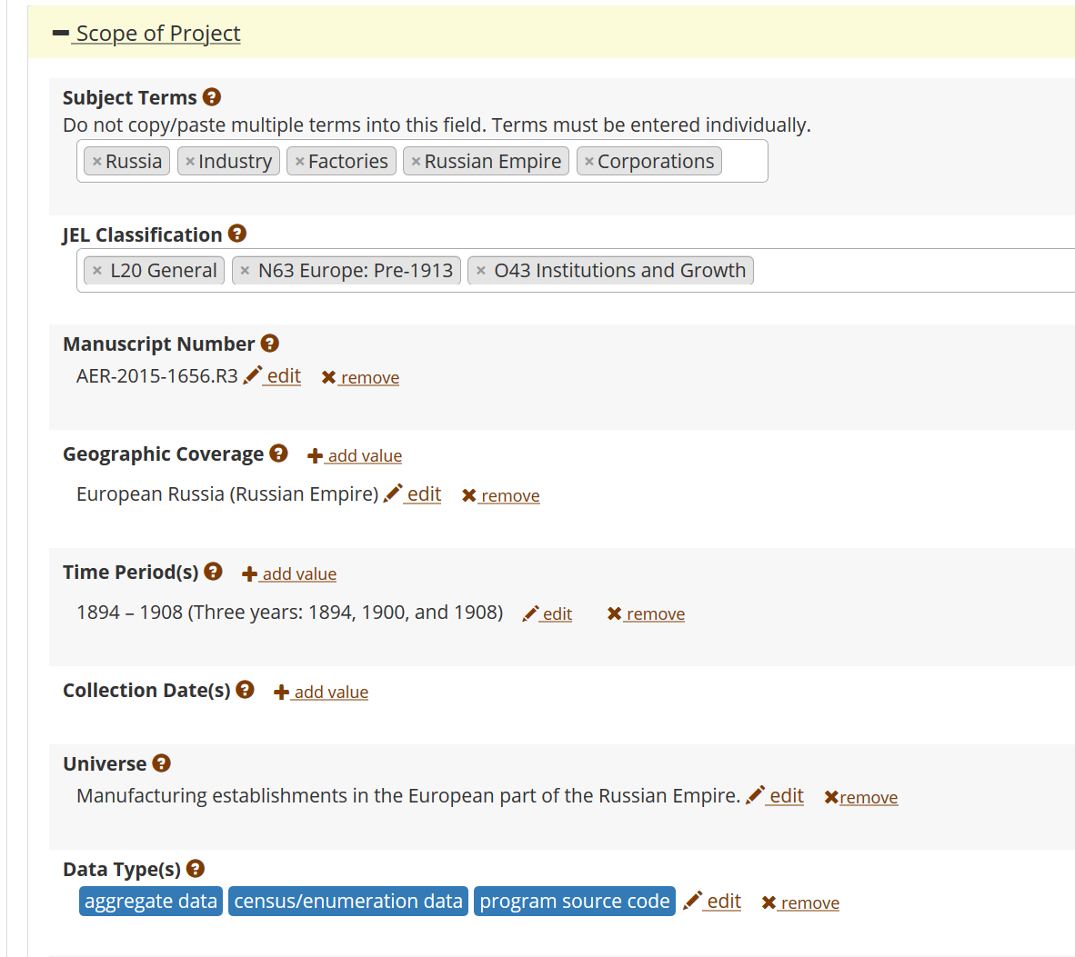
FAIR data principles rely on metadata
Notes:
Show metadata for this page

Slide 43
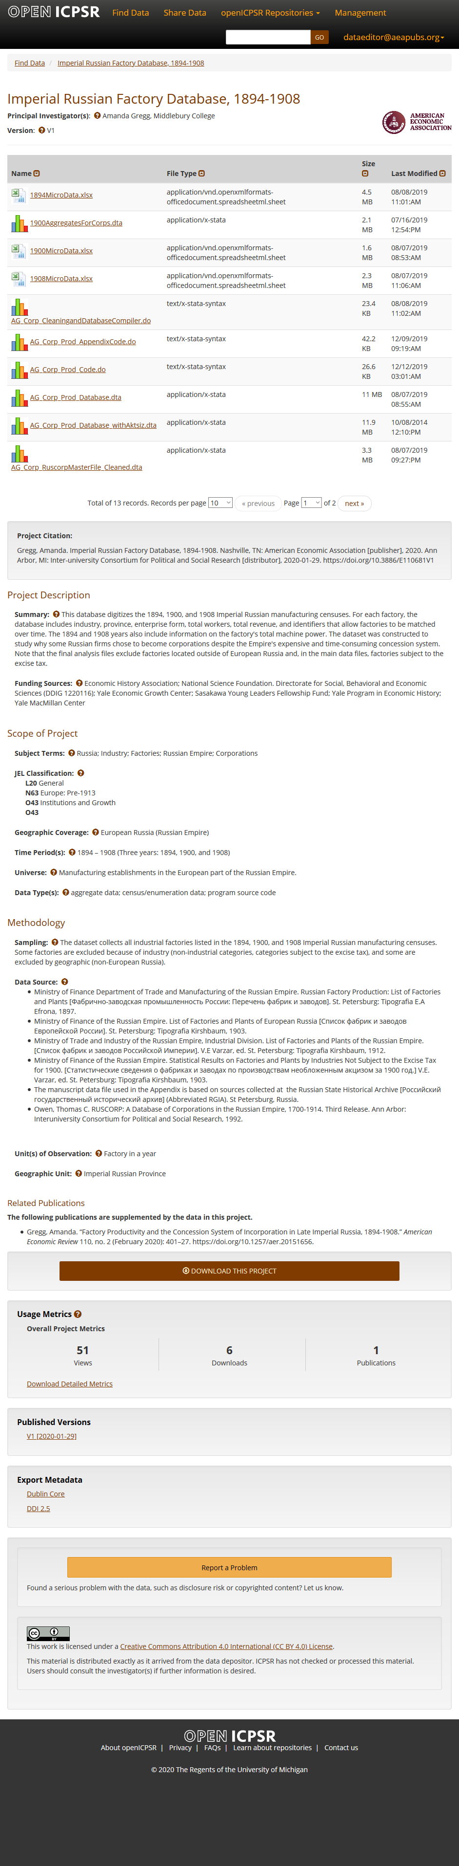

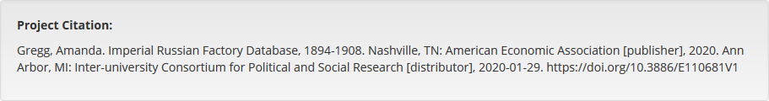
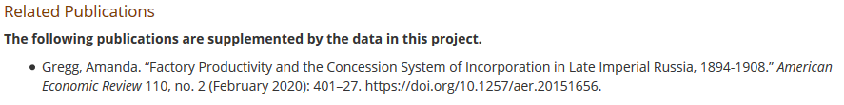

Slide 44
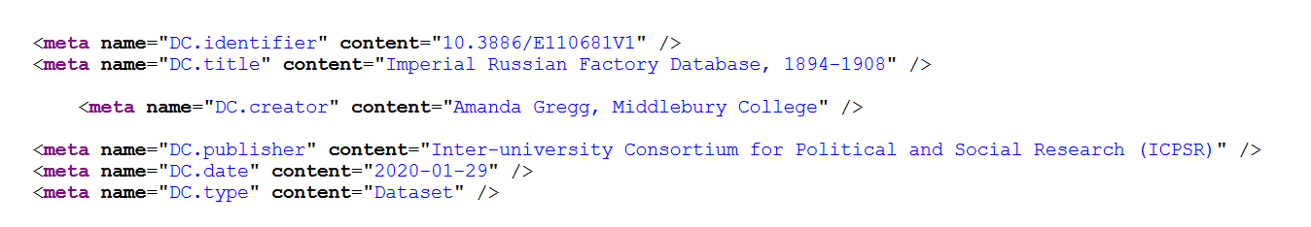

Slide 45
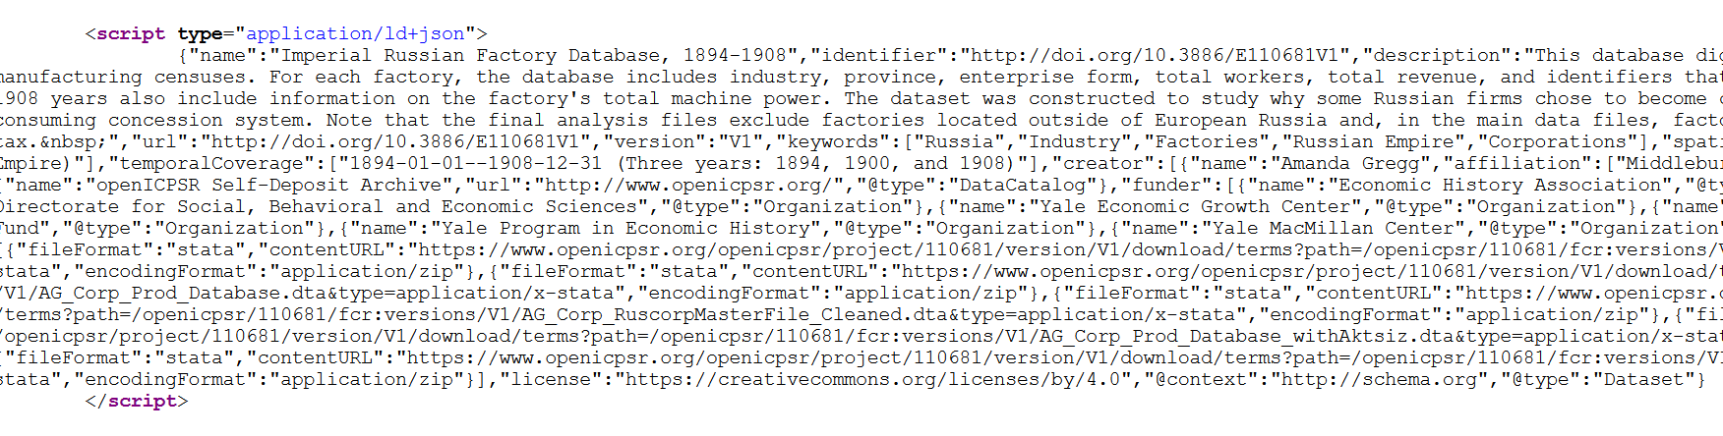

Slide 46
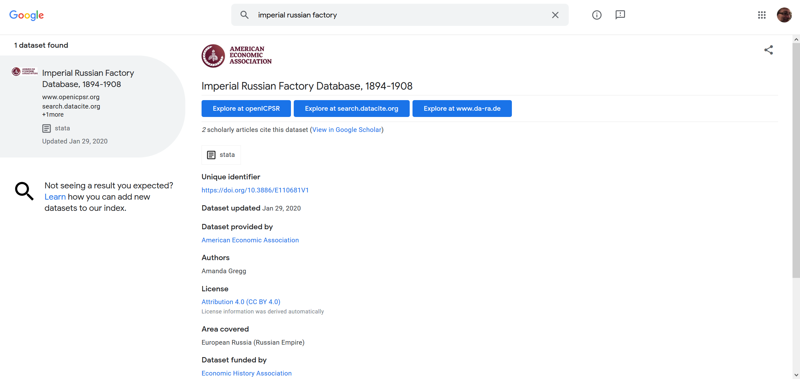
… and findability relies on metadata

Slide 47
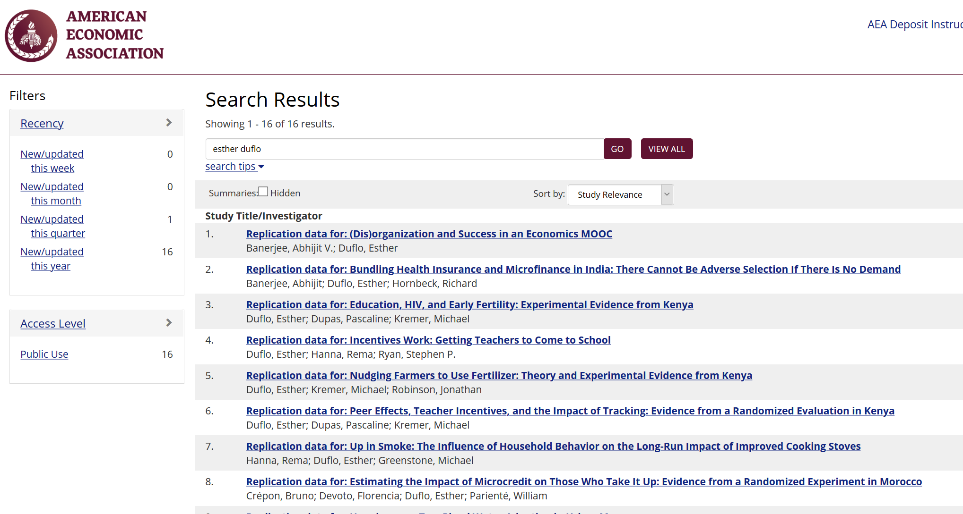

Slide 48
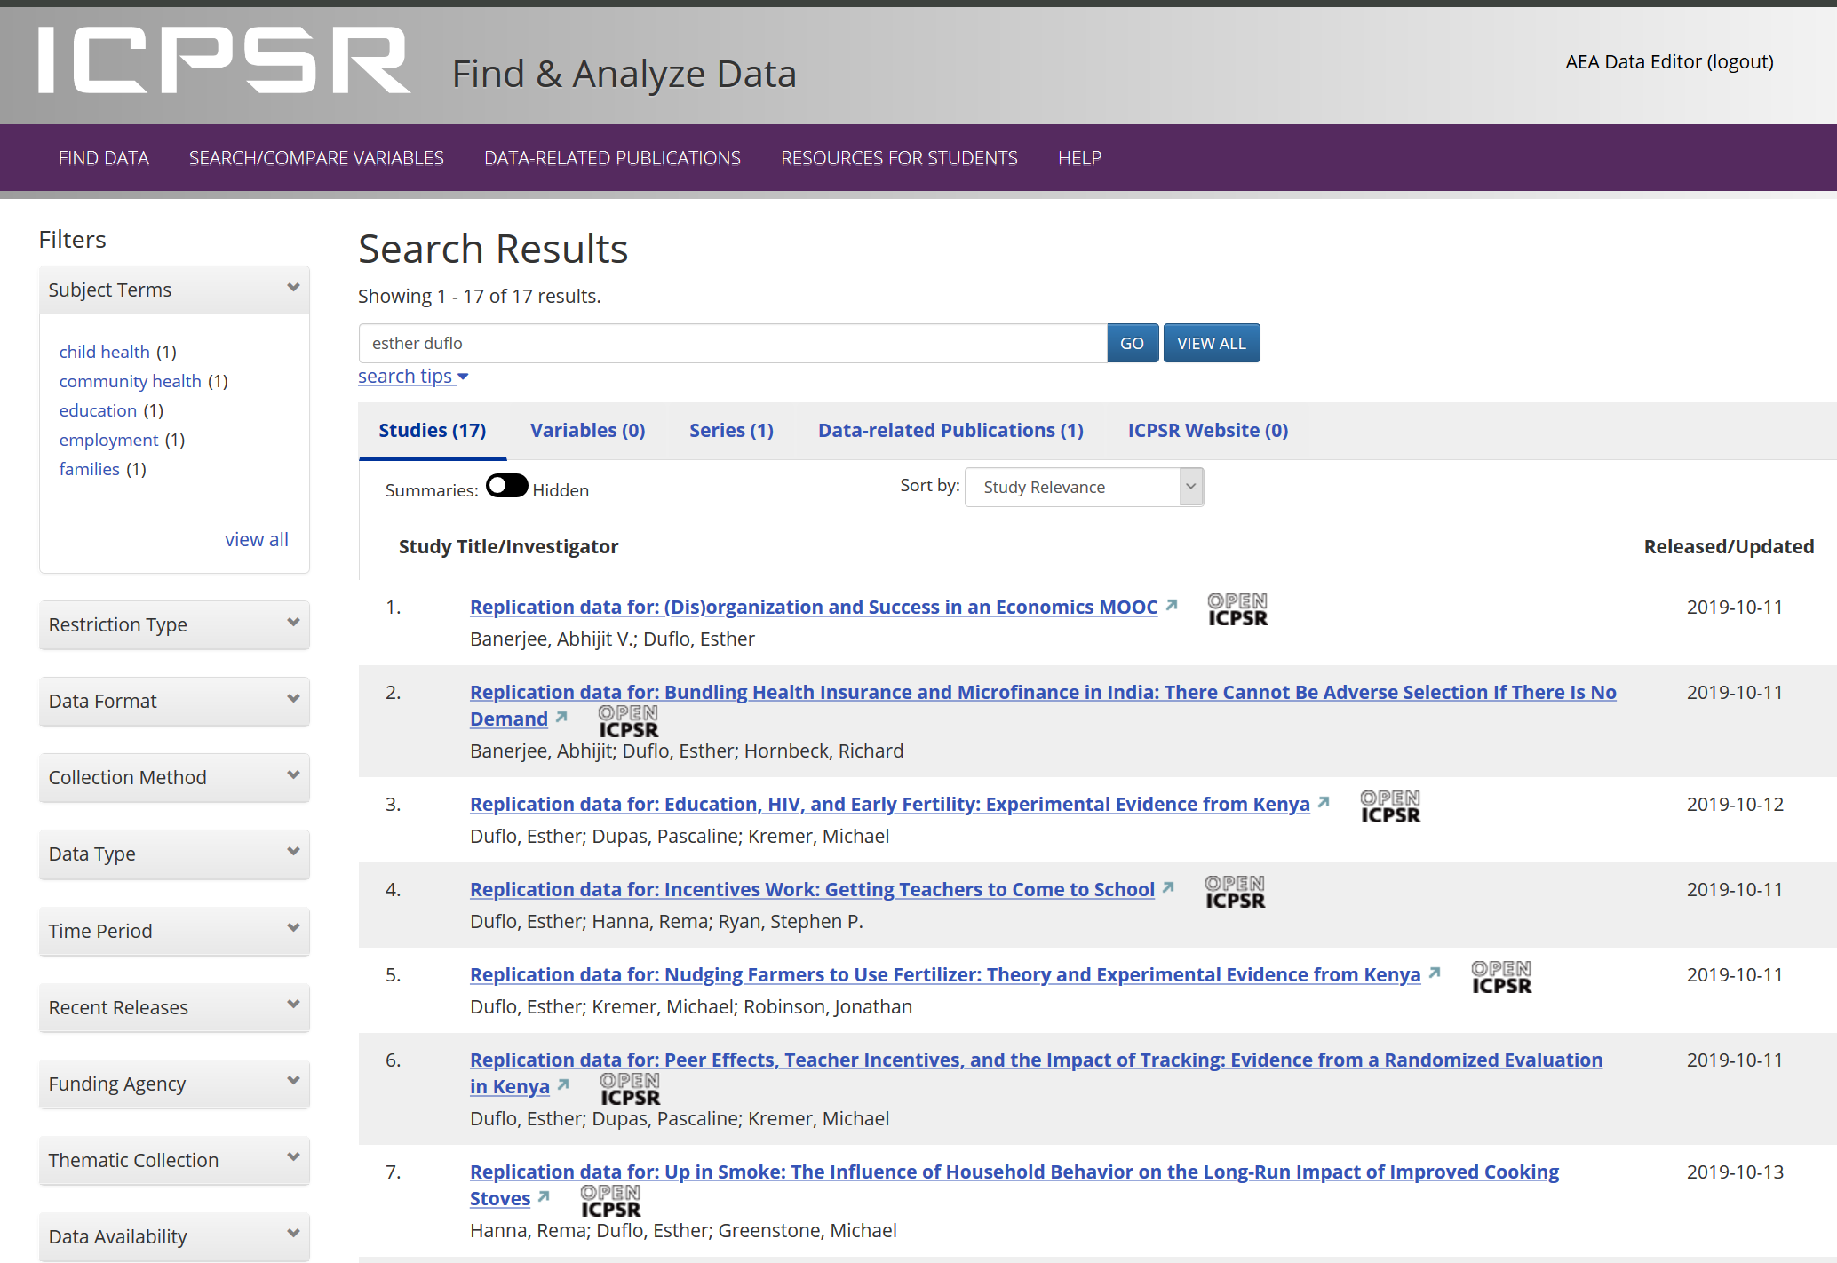

Slide 49
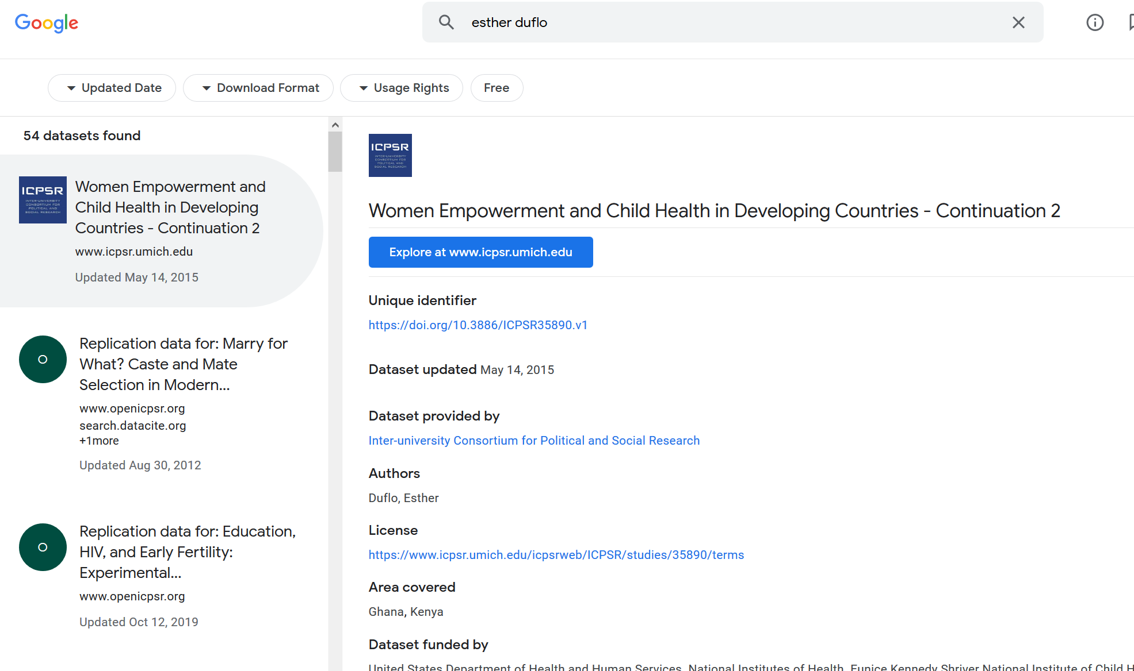

Slide 50
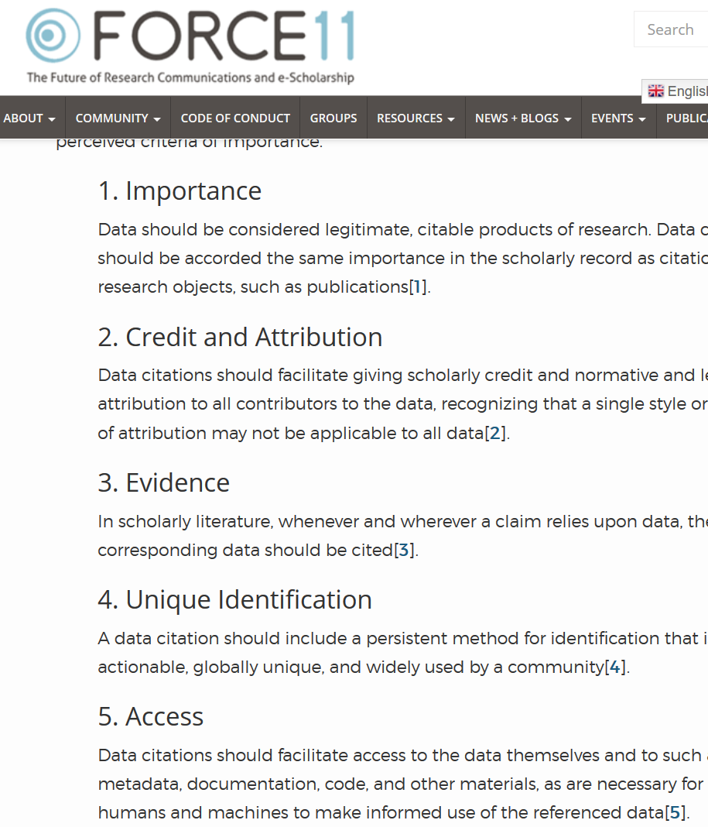

Starts with Data Citations
Data Citation Principles
Image of a standard data citation
Data Citation Synthesis Group: Joint Declaration of Data Citation Principles. Martone M. (ed.) San Diego CA: FORCE11; 2014 [https://www.force11.org/group/joint-declaration-data-citation-principles-final].

Slide 51
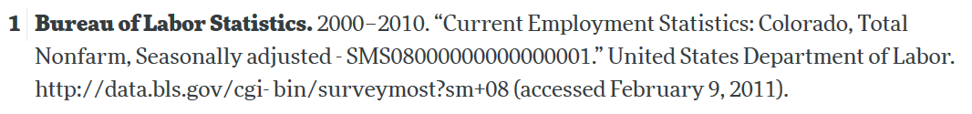
Starts with Data Citations
Data Citation Principles
Image of a standard data citation
Data Citation Synthesis Group: Joint Declaration of Data Citation Principles. Martone M. (ed.) San Diego CA: FORCE11; 2014 [https://www.force11.org/group/joint-declaration-data-citation-principles-final].

Slide 52
Observation 3
Social scientists are not trained to cite data

Slide 53
Citing restricted-access data
“Well, I can’t download the data, so I can’t cite it.”

Slide 54
Some practical tips
(based on 1000 articles)

Slide 55
1. Computational empathy
Focal reader: your next RA in 4 years (or maybe you…)
Interaction: you hand them your README, but don’t have time to go through all the details…
Budget constraint: It shouldn’t take too many RA hours
Time constraint: It shouldn’t take more than 1 week to “get it”

Slide 56
Solution 1: Computational Empathy
Use the Social Science Data Editors’ template README https://doi.org/10.5281/zenodo.4319999

Slide 57
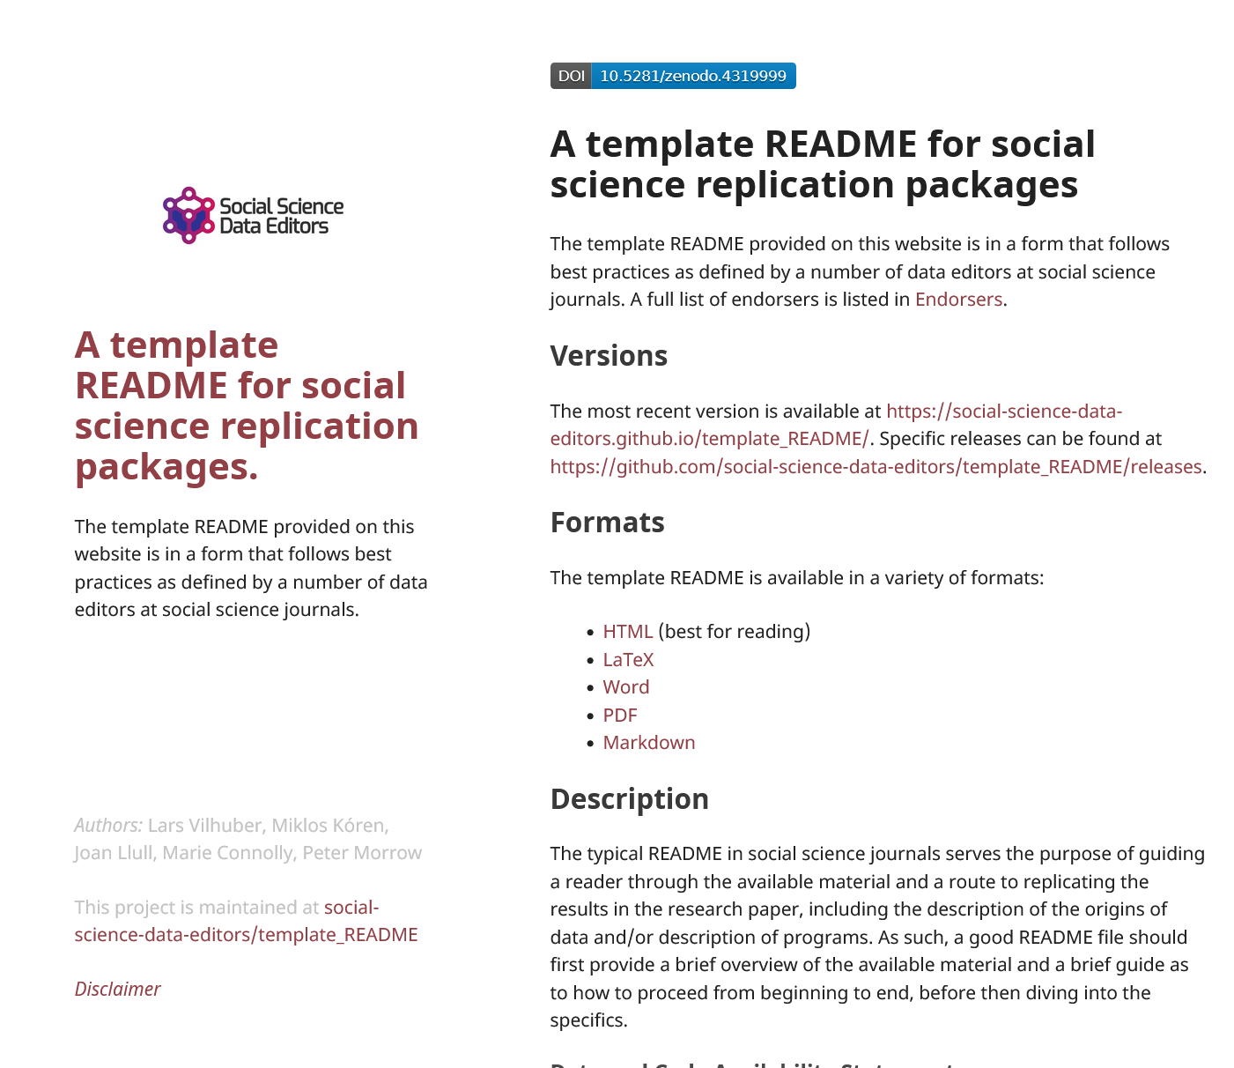
1. Computational empathy
Focal reader: your next RA in 4 years (or maybe you…)
Interaction: you hand them your README, but don’t have time to go through all the details…
Budget constraint: It shouldn’t take too many RA hours
Time constraint: It shouldn’t take more than 1 week to “get it”

Slide 58
Keeping track: Students and Researchers
Computational empathy Consider the next person to run the analysis, and don’t assume too much

Slide 59
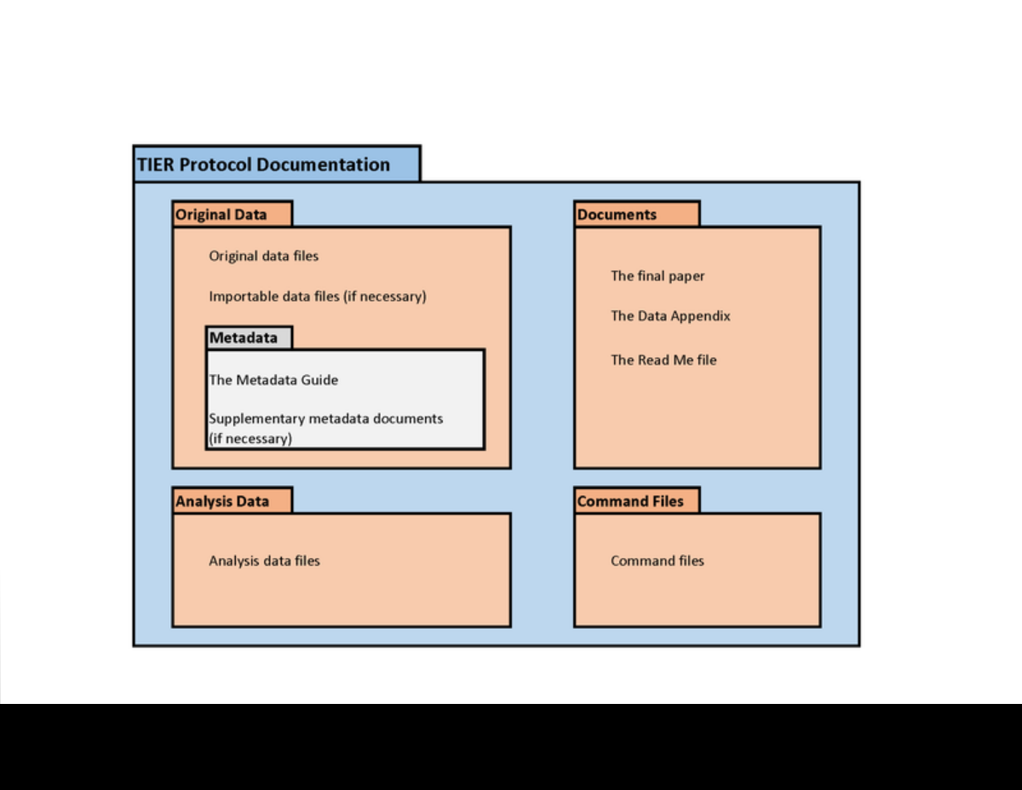

2. Keeping track of data: Data provenance
Keep all information as you collect data
See TIER Protocol for good and simple guidance
If you must use a point-and-click tool, keep detailed instructions
Also: obsolescence
Try to use API, bulk download, or packages that allow for extraction
Also: obsolescence of API

Slide 60
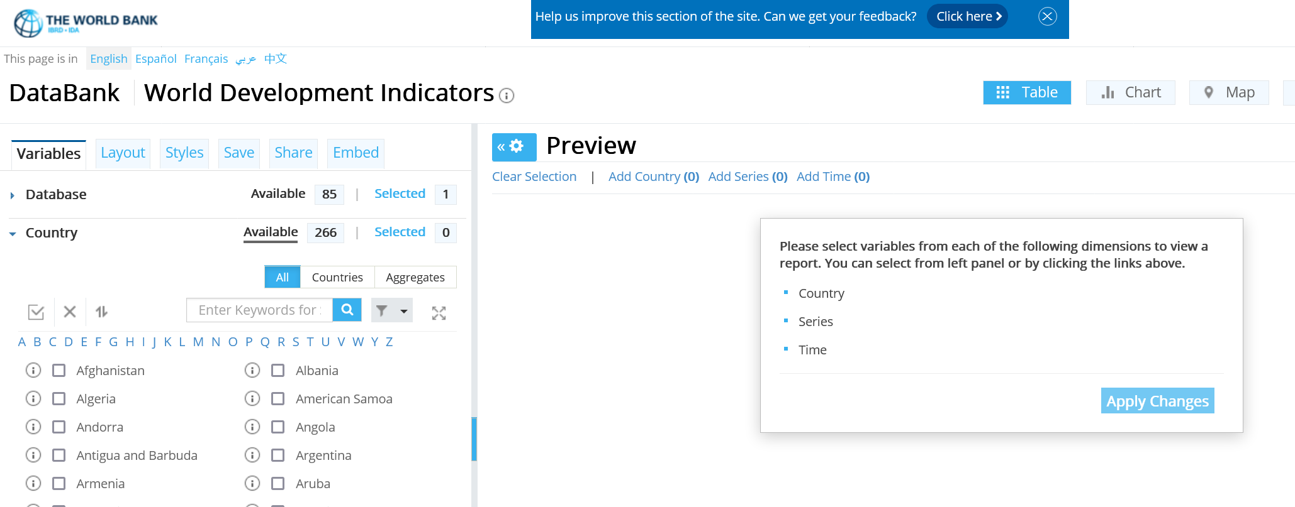
API? But the interface is so cool!
World Development Indicators

Slide 61
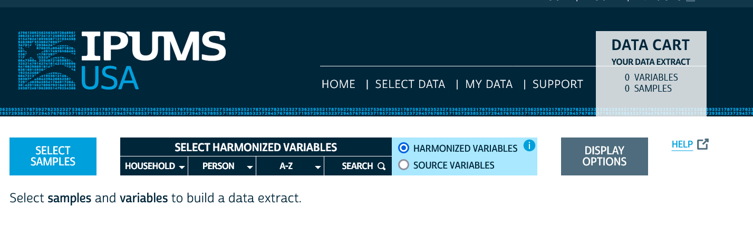
API? But the interface is so cool!
IPUMS

Slide 62
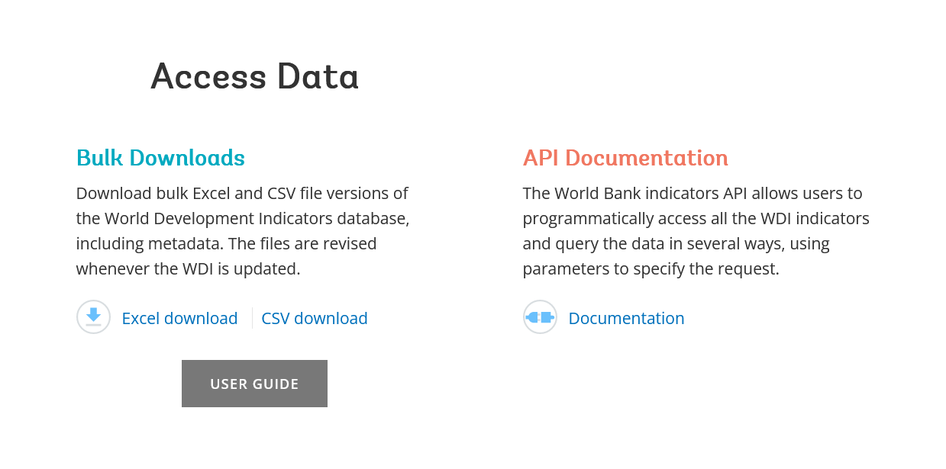
API or Bulk Download
World Development Indicators

Slide 63
API or Bulk Download
World Development Indicators
. ssc install wbopendata
. wbopendata, country(ago;bdi;chi;dnk;esp) indicator(sp.pop.0610.fe.un) /// > year(2000:2010) clear long

Slide 64
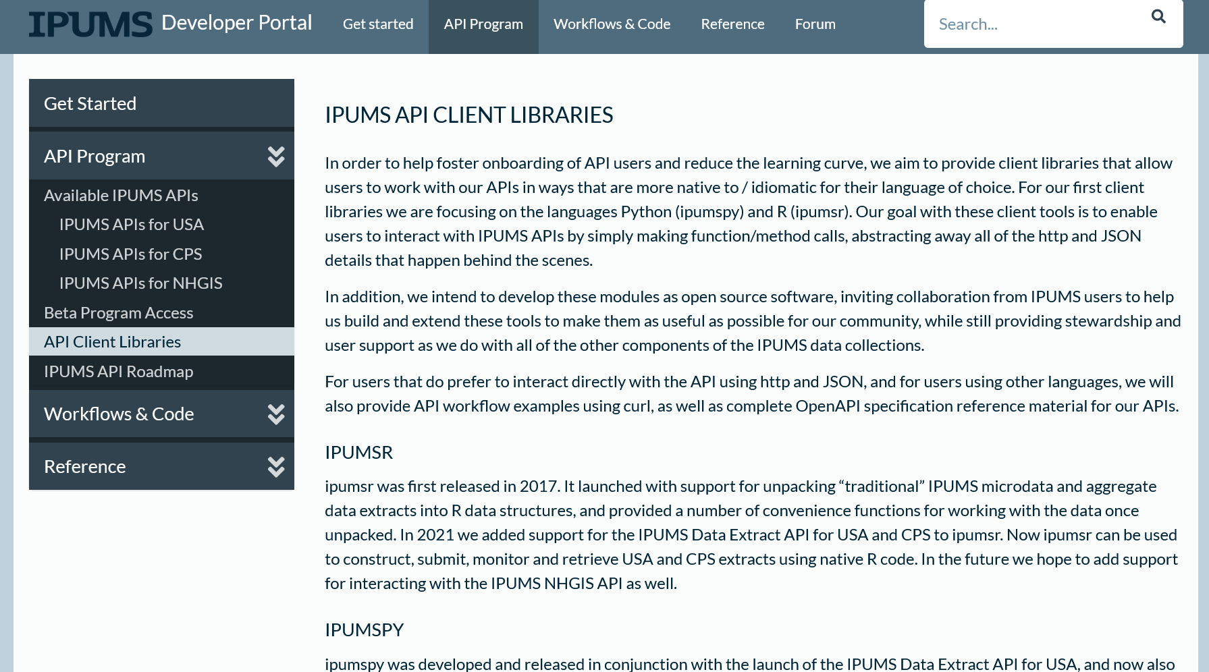
API or Bulk Download
IPUMS (beta)

Slide 65
2. Keeping track of data:
Don’t forget to check the TERMS of USE!

Slide 66
Observation 4
(Academic) Social scientists do not read the terms of use

Slide 67
Because you may not be able to provide others with a copy of the data (legally)…*
* A recent set of court cases in the US can be thought to authorize web scraping, but my interpretation is that it only says “web scraping is not the same as computer hacking” which is illegal, but does NOT say that web scraping is allowed. See Bryan et al (2022).
Notes:
A recent set of court cases in the US can be thought to authorize web scraping, but my interpretation is that it only says “web scraping is not the same as computer hacking” which is illegal, but does NOT say that web scraping is allowed. See Bryan et al (2022).

Slide 68
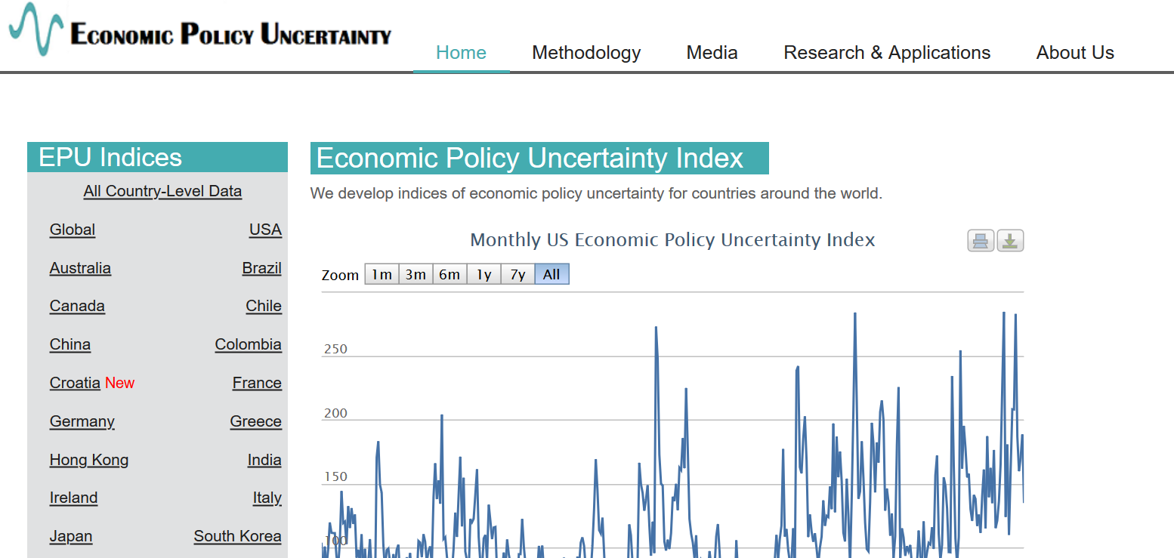
Example 2: Academic data publisher

Slide 69

Example 2: Academic data publisher

Slide 70

Example 2: Academic data publisher-new!

Slide 71
Distinguish right to use from right to provide to others
Website
Your analysis
Right to redistribute code + results
Public replication package
Right to use
Data
Ability to access
Right to redistribute data

Slide 72
Rights to use data
You browsed a website
You purchased the data
You signed a data use agreement
You created the data (lab experiment)
You had survey respondents consent to use (IRB approval!)

Slide 73
Rights to distribute the data
If you created the data, you decide.
If you got it from somewhere else:
READ THE TERMS OF USE / DATA USE AGREEMENT / CLICK-THROUGH / ETC.

Slide 74
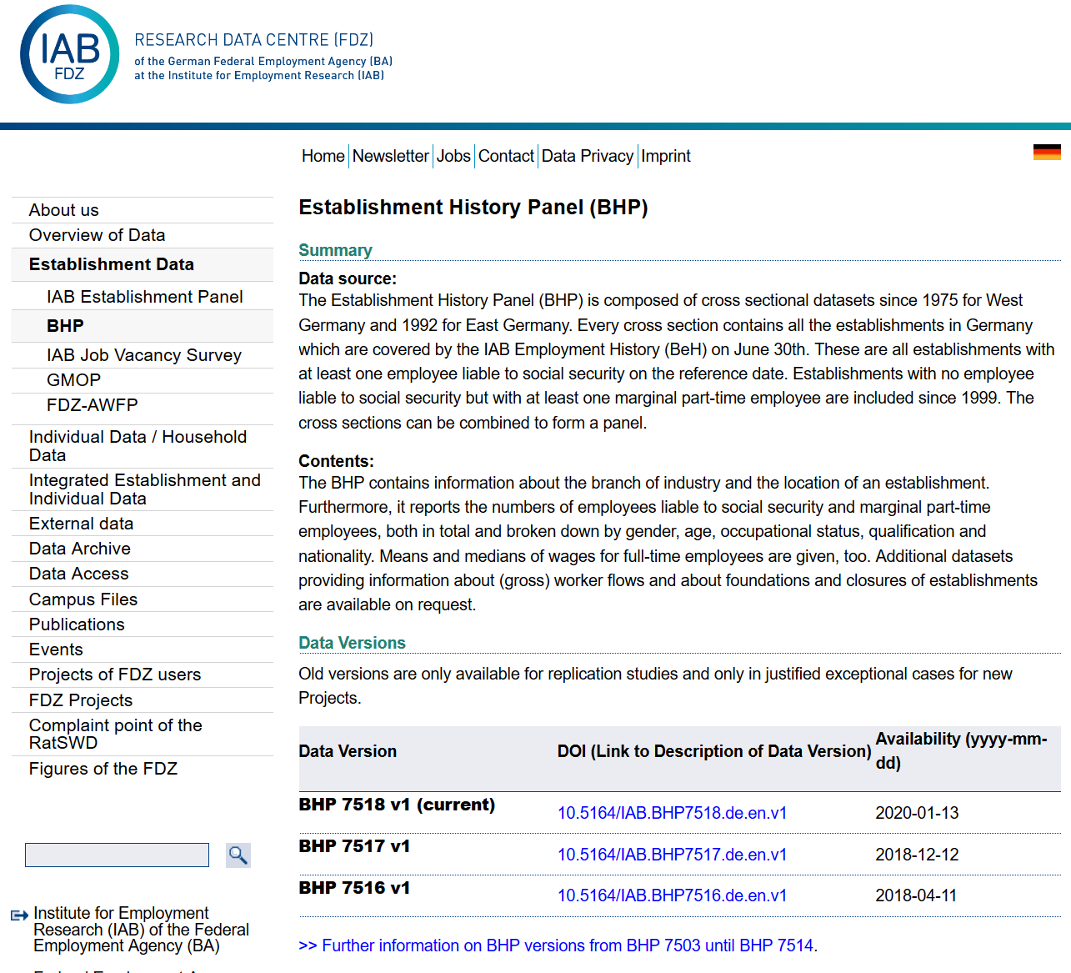
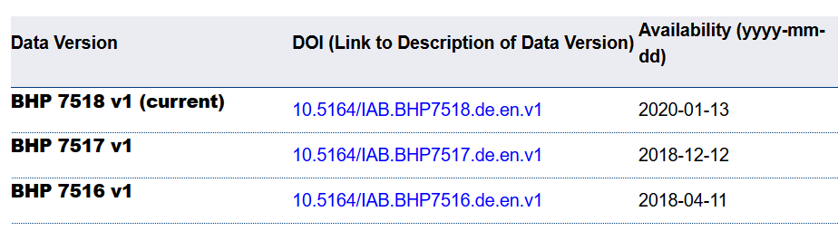
Example 4: German Restricted-access

Slide 75

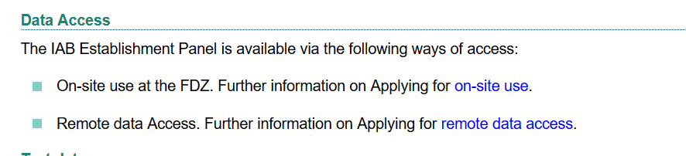
Example 4: German Restricted-access

Slide 76
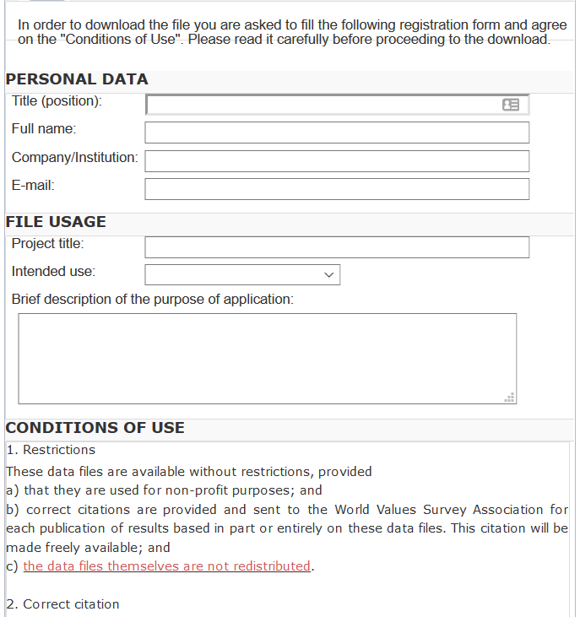
And we check them!
What does the site say?
Please use the following citation when referring to this file in the different versions: Inglehart, R., C. Haerpfer, A. Moreno, C. Welzel, K. Kizilova, J. Diez-Medrano, M. Lagos, P. Norris, E. Ponarin & B. Puranen et al. (eds.). 2014. World Values Survey: Round Six - Country-Pooled Datafile Version: www.worldvaluessurvey.org/WVSDocumentationWV6.jsp. Madrid: JD Systems Institute.
Is that in the README / Paper/ Appendix?
Are all the conditions met/described?

Slide 77
Solution 2: Data Provenance
Keep detailed notes
script as much as possible
(also: Use the Social Science Data Editors’ template README)

Slide 78
Keeping track: Students and Researchers
Computational empathy Consider the next person to run the analysis, and don’t assume too much
Track data (provenance) even when using API, especially when manually downloading, keep in mind what the next downloader may see/find/receive, terms of use

Slide 79
Coding for Reproducibility

Slide 80
Lesson 1: Computational empathy
= “Pity the poor replicator”

Slide 81

Streamlining replication packages
Master script preferred
Least amount of manual effort
No manual manipulation
“Change the parameter to 0.2, then run the code again”
No manual copying of results
Write out/save tables and figures using packages
Compute all numbers in package
No manual install of packages
Use a script to create all directories, install all necessary packages/requirements/etc.
Clear instructions!

Slide 82
Observation 5
(Academic) Social scientists do not read the manual… (or at least not some key parts)

Slide 83
Extreme examples
Matlab-based simulation
Real example, 10 figures, 4 panels each
For Figure 5a, comment line 52, uncomment line 151, run the code, then copy the figure into your document.
For Figure 5b, comment line 151 again, leave line 52 commented, and change the parameter on line 75 to “3”
….

Slide 84
Extreme examples
Matlab-based simulation
Real example, 10 figures, 4 panels each
For Figure 5a, comment line 52, uncomment line 151, run the code, then copy the figure into your document.
For Figure 5b, comment line 151 again, leave line 52 commented, and change the parameter on line 75 to “3”
….
Write re-usable code
Use primitive I/O to read parameter files

Slide 85
Extreme examples
Stata-based estimation
4 variants
Run the data creation programs, then copy the data to Folder A
Copy programs “b.do” and “c.do” from Folder A to Folder B, but modify “c.do” on line 20
Once done, convert the output from “d.do” to a Matlab file, and run the simulation in Folder B/C
….

Slide 86
Extreme examples
Stata-based estimation
4 variants
Run the data creation programs, then copy the data to Folder A
Copy programs “b.do” and “c.do” from Folder A to Folder B, but modify “c.do” on line 20
Once done, convert the output from “d.do” to a Matlab file, and run the simulation in Folder B/C
….
Re-use code files (ado)
Use relative or root-relative paths

Slide 87
Ideal setup
1 program to prepare the setup
Installs all packages
Creates all directories
1 program (or a very small number) that creates the rest
Possibly with macros/ ado files/ subroutines
Possibly with parameter files that might differ per directory
All tables and figures are output programmatically
Setting up can be done in all languages
Matlab, Stata, R, Python, Fortran
Subroutines exist in all languages
You might need to learn how!
Ability to output figures and tables (Excel, LaTeX) exist in all languages

Slide 88
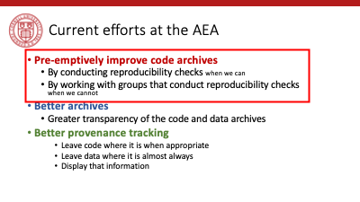
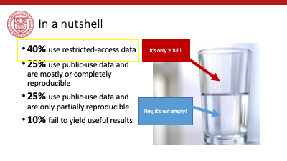
Tension between access and reproducibility

Slide 89


Verification services

Slide 90
Assume replicators can access the data
Sometimes we (=AEA) cannot
We will still check if the code seems complete
We will still verify that all data that *can* be provided have been provided
Plausibility checks
Sometimes we can:
In the past, we have worked with
French, Brazilian, and US confidential admin data
Purchased commercial data (Twitter, Indian GDP)
Proprietary data under NDA/DUA (Ebay)
Data with application procedure (Chinese Panel, Demographic and Health Survey, European establishment data)
Remotely or locally

Slide 91
Solution 3: Learn basics of programming
Code reproducibly
(and do so right from the start)
(also: way easier to describe in the Social Science Data Editors’ template README)

Slide 92
Keeping track: Students and Researchers
Computational empathy Consider the next person to run the analysis, and don’t assume too much
Track data even when using API, especially when manually downloading, keep in mind what the next downloader may see/find/receive, terms of use
Learn the basics of programming code reproducibly, use parameter files, re-usable code, robust file structure

Slide 93
That’s a lot of stuff to learn and remember… I want to focus on the economics!

Slide 94
Keeping track: Students and Researchers
Computational empathy Consider the next person to run the analysis, and don’t assume too much
Track data even when using API, especially when manually downloading, keep in mind what the next downloader may see/find/receive, terms of use
Learn the basics of programming code reproducibly, use parameter files, re-usable code, robust file structure
Learn to automate Run all code again and again, use APIs to download, use conditional processing to handle various aspects
Preserve it all Use version control, tag releases, preserve data (separately), understand the difference between sharing and preserving

Slide 95
That’s a lot of stuff to learn and remember… I want to focus on the economics!

Slide 96
Support by Institutions

Slide 97
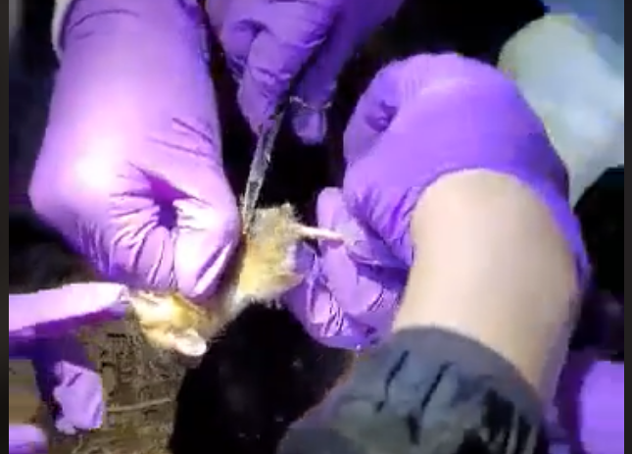
Lesson 3: Support by institutions is insufficient
When should these skills be taught?
These are core “tools of the trade”!
Undergrad, core part of graduate curricula
In other disciplines: students learn how to collect use a pipette, how to tag field mice in the wild…

Slide 98
Lesson 3: Support by institutions is insufficient
Should all of these skills be taught?
How to deposit data
How to set up a compute cluster
Some of these skills fall into other categories, but
Data librarians are understaffed, and not trained in discipline-specific practices
Campus IT has highly varying funding and consulting time
Cross-campus IT practices are nowhere close to compatible

Slide 99
Lesson 3: Support by institutions is insufficient
Institutional funding and mandates are not adequate
Most grant funding in social sciences does not require (or allow!) for this kind of budgeting
Earmarked portions of funds would be great!
(This is slowly coming, NSF and NIH are making progress)
(Most) Universities consider this an external mandate, not part of their “overhead”
“Provide us with an account, and we will do it”
Leads to highly scattershot infrastructure

Slide 100
Lesson 3: Support by institutions is insufficient
Disciplinary institutions need funding
Direct funding: should archives be treated like infrastructure?
This is the case in many NIH archives
Not quite as ubiquitous in social sciences
Where do you want to preserve 1TB per user per day for the next 50 years? It’s not free…
Indirect funding (via grants)
See previous slide

Slide 101
Lesson 3: Support by institutions is insufficient
All institutions need to consider the user experience
Data provenance and preservation would be a lot easier to implement if scripted
Need for APIs both for upload and download (usage)
Some progress: Zenodo and Dataverse (usually Python, sometimes R)

Slide 102
Lesson 3: Support by institutions is insufficient
Integration of computational resources with data resources is highly inadequate
Most journals have “data” policies, but all research compendia have code – this is a problem with many publishers
Most data repositories are optimized for … data. Support for computational code or actual execution is at best preliminary
See CodeOcean, WholeTale, efforts around Dataverse
See various “continuous integration” using Github, Travis CI, etc. but difficult to integrate data

Slide 103
Solution 6: Institutional support
(departments, schools, libraries, IT, universities)
Offer training in adapted tools (not sufficient to just show how to do a Rmarkdown document)
Highlight appropriate community (Zenodo, Dataverse, others) or university sites
Provide streamlined access to some frequently used (open/commercial) tools (AWS/GCS/Azure, CI on Github/others, etc.)

Slide 104
Some thoughts for the role of Faculty
Encourage students to learn new skills outside of economics Even or especially if you do not have the time to do so
Demand reproducibility when reviewing (articles, theses, intermediate reports from students, etc.) automated re-runs on Github, which particular release to review, refusing emailed copies
Incentivize reproducibility For robustness, for efficiency, but also training for exposure to the discipline. Example: Replication Challenges

Slide 105

Please don’t produce irreproducible articles!

Slide 106
The role for journals

Slide 107
Goal: Transportability
Any standards, tools, methods: must be transportable across journals (no custom solutions)

Slide 108

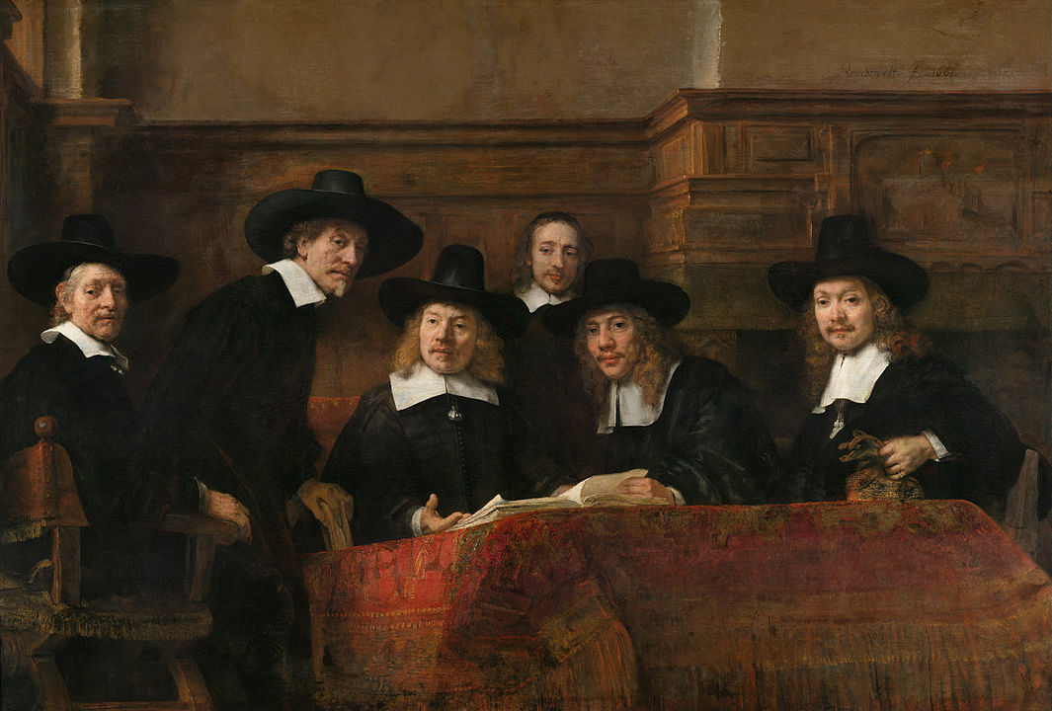
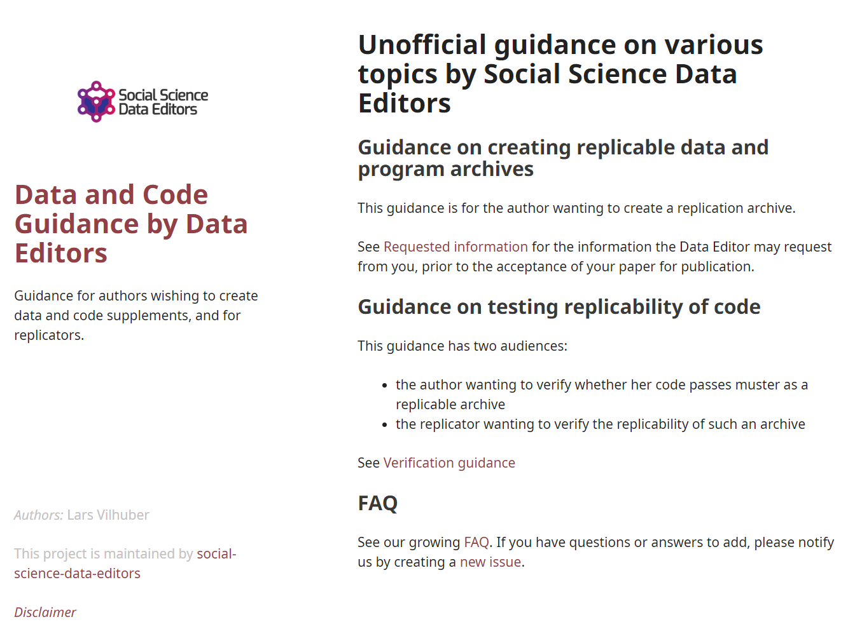
Social science “guild”
https:// social-science -data-editors. github.io/ guidance/

Slide 109
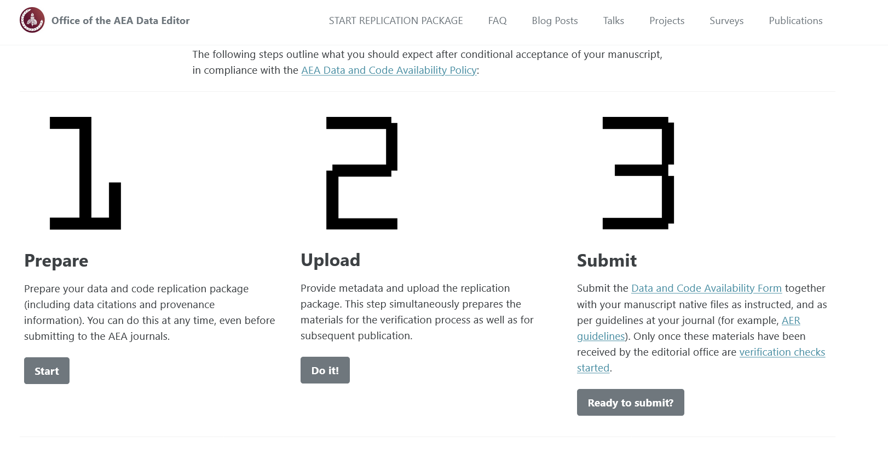

Some resources
https://social-science-data-editors.github.io/guidance/
template README
discussion of licensing
data citation guidance
https://aeadataeditor.github.io/

Slide 110
Thank you!

Slide 111
Reminder: Students and Researchers
Computational empathy Consider the next person to run the analysis, and don’t assume too much
Track data even when using API, especially when manually downloading, keep in mind what the next downloader may see/find/receive, terms of use
Learn the basics of programming code reproducibly, use parameter files, re-usable code, robust file structure
Learn to automate Run all code again and again, use APIs to download, use conditional processing to handle various aspects
Preserve it all Use version control, tag releases, preserve data (separately), understand the difference between sharing and preserving

Slide 113
Example of data provenance

Slide 114
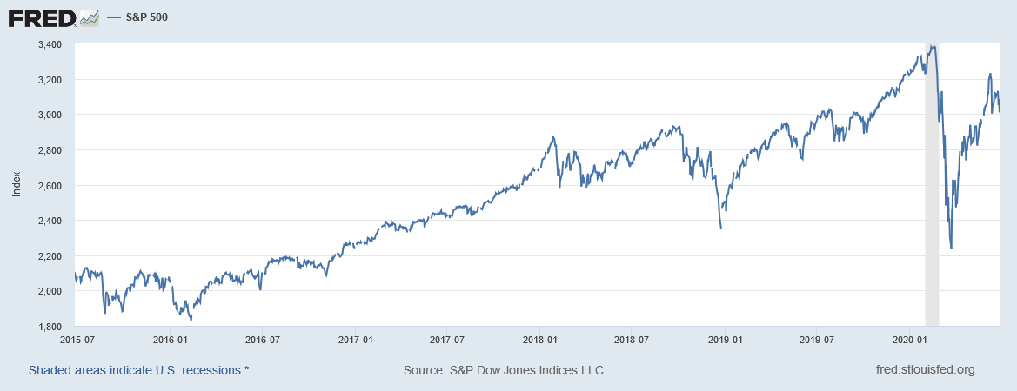
“It’s a file called stockmarket.xlsx”
2101.49
2057.64
2063.11
2077.42
2076.78
0
2068.76
2081.34
2046.68
2051.31
2076.62
2099.60
2108.95
2107.40
2124.29
2126.64
2128.28
2119.21
2114.15
2102.15
2079.65
2067.64
2093.25
2108.57
2108.63
2103.84

Slide 115
“It’s a file called SP500.xlsx”
SP500 | S&P 500, Index, Daily, Not Seasonally Adjusted
Frequency: Daily, Close
observation_date | SP500
2015-06-26 | 2101.49
2015-06-29 | 2057.64
2015-06-30 | 2063.11
2015-07-01 | 2077.42
2015-07-02 | 2076.78
2015-07-03 | 0
2015-07-06 | 2068.76
2015-07-07 | 2081.34
2015-07-08 | 2046.68
2015-07-09 | 2051.31
2015-07-10 | 2076.62
2015-07-13 | 2099.60
2015-07-14 | 2108.95
2015-07-15 | 2107.40
2015-07-16 | 2124.29
2015-07-17 | 2126.64
2015-07-20 | 2128.28

Slide 116
“It’s a file called SP500.xlsx, downloaded from FRED.”
SP500 | S&P 500, Index, Daily, Not Seasonally Adjusted
Frequency: Daily, Close
observation_date | SP500
2015-06-26 | 2101.49
2015-06-29 | 2057.64
2015-06-30 | 2063.11
2015-07-01 | 2077.42
2015-07-02 | 2076.78
2015-07-03 | 0
2015-07-06 | 2068.76
2015-07-07 | 2081.34
2015-07-08 | 2046.68
2015-07-09 | 2051.31
2015-07-10 | 2076.62
2015-07-13 | 2099.60
2015-07-14 | 2108.95
2015-07-15 | 2107.40
2015-07-16 | 2124.29
2015-07-17 | 2126.64
2015-07-20 | 2128.28

Slide 117
“It’s a file called SP500.xlsx, downloaded from FRED.”
S&P Dow Jones Indices LLC. 2020. “S&P 500 [SP500] [dataset]”, retrieved from FRED, Federal Reserve Bank of St. Louis; https://fred.stlouisfed.org/series/SP500, June 26, 2020.
SP500 | S&P 500, Index, Daily, Not Seasonally Adjusted
Frequency: Daily, Close
observation_date | SP500
2015-06-26 | 2101.49
2015-06-29 | 2057.64
2015-06-30 | 2063.11
2015-07-01 | 2077.42
2015-07-02 | 2076.78
2015-07-03 | 0
2015-07-06 | 2068.76
2015-07-07 | 2081.34
2015-07-08 | 2046.68
2015-07-09 | 2051.31
2015-07-10 | 2076.62
2015-07-13 | 2099.60
2015-07-14 | 2108.95
2015-07-15 | 2107.40
2015-07-16 | 2124.29
2015-07-17 | 2126.64
2015-07-20 | 2128.28

Slide 118
“SP500.xlsx, from S&P (2020). Not provided as part of replication package because © S&P. ”
S&P Dow Jones Indices LLC. 2020. “S&P 500 [SP500] [dataset]”, retrieved from FRED, Federal Reserve Bank of St. Louis; https://fred.stlouisfed.org/series/SP500, June 26, 2020.
SP500 | S&P 500, Index, Daily, Not Seasonally Adjusted
Frequency: Daily, Close
observation_date | SP500
2015-06-26 | 2101.49
2015-06-29 | 2057.64
2015-06-30 | 2063.11
2015-07-01 | 2077.42
2015-07-02 | 2076.78
2015-07-03 | 0
2015-07-06 | 2068.76
2015-07-07 | 2081.34
2015-07-08 | 2046.68
2015-07-09 | 2051.31
2015-07-10 | 2076.62
2015-07-13 | 2099.60
2015-07-14 | 2108.95
2015-07-15 | 2107.40
2015-07-16 | 2124.29
2015-07-17 | 2126.64
2015-07-20 | 2128.28

Slide 119
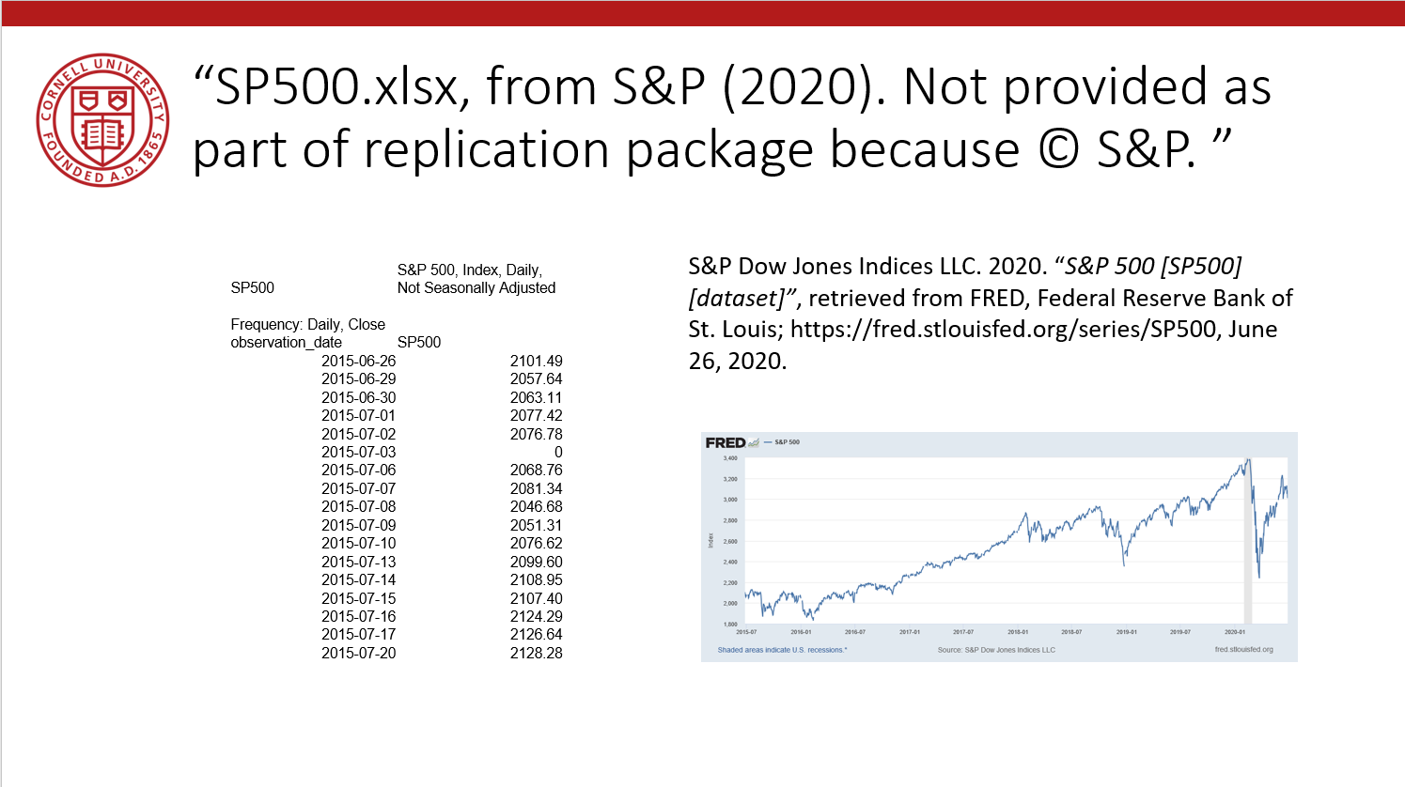
Data Availability Statements
Describes data file, where to get it, how to get it, and any conditions of obtaining it

Slide 120
Data Citations

Slide 121
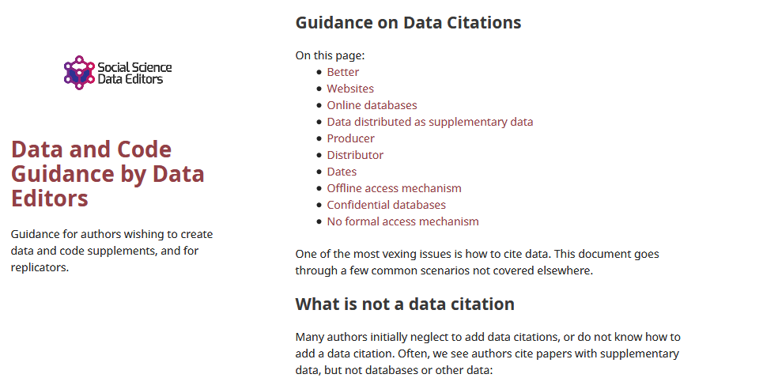
Data citations
Creating specific guidance in the absence of strong discipline-specific guidance
https://social-science-data-editors.github.io/guidance/addtl-data-citation-guidance.html

Slide 122
Example 4: German Restricted-access

Slide 123
Data Citation
Attributes the file to the proper source

Slide 124
Element of a (data) citation
ICPSR notes that a citation should include the following items:
Author
Title
Distributor
Date
Version
Persistent identifier
Suggested Citation:
S&P Dow Jones Indices LLC, S&P 500 [SP500], retrieved from FRED, Federal Reserve Bank of St. Louis; https://fred.stlouisfed.org/series/SP500, June 26, 2020.

Slide 125
Element of a (data) citation
ICPSR notes that a citation should include the following items:
Author
Title
Distributor
Date
Version
Persistent identifier
Constructed Citation:
Institute for Employment Research (IAB), Establishment History Panel 1975-2018. Accessed via the Research Data Centre (FDZ) of the German Federal Employment Agency DOI: 10.5164/IAB.BHP7518.de.en.v1 June 26, 2020.

Slide 126
Element of a (data) citation
ICPSR notes that a citation should include the following items:
Author
Title
Distributor
Date
Version
Persistent identifier
Constructed Citation:
US Census Bureau, Longitudinal Business Database (LBD) 1975-2018. Last accessed via the Federal Statistical Research Data Centre (FSRDC) June 26, 2020.

Slide 127
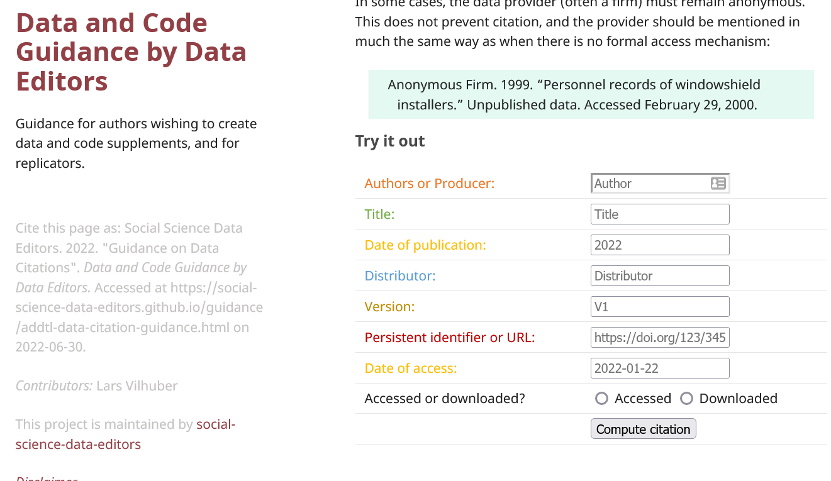
Try it out yourself
Construct an (approximate) data citation
https://social-science-data-editors.github.io/guidance/addtl-data-citation-guidance.html#try-it-out

Slide 128
Data: Citations, Access, Rights
Any data can be cited – even if you can’t download it
Any data that you accessed … can have that access be described
But caution: It should be such that others can also repeat the access!
Just because you “have” the data does not mean you can give it to others
Also: distinguish between “sharing” and “publishing”
Know your terms of use!

Slide 129
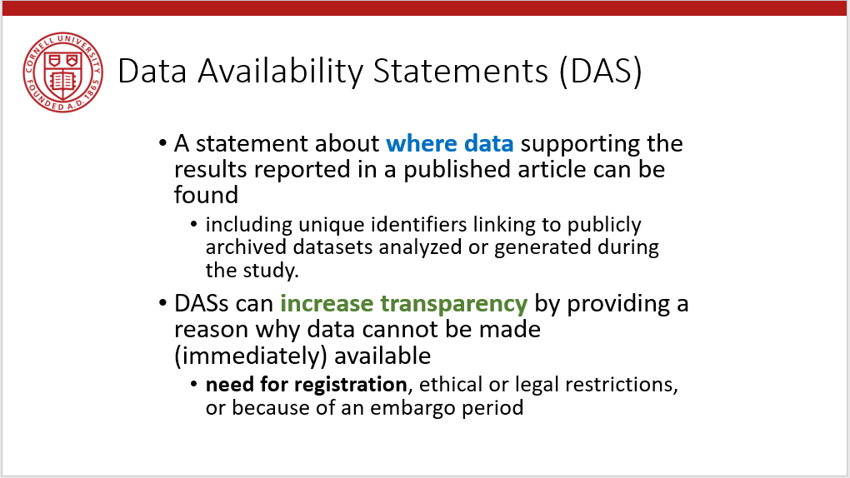
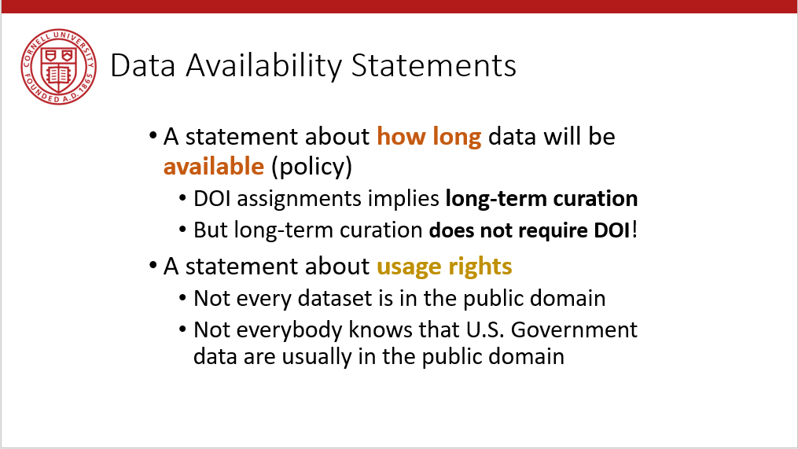
Provide data citations (in manuscript) and data availability statements (in README or appendix)

Slide 130
Solution 3: Data Citations
Cite every data source
(not only the paper that describes the source!)
(also: add them to the Social Science Data Editors’ template README)

